Slide 1

GATHER: a family and collaboration application
CS 440: Development Project
Software in support for Distributed Collaboration
Akshant Jain, Ayna Jain, Shaan Shekhar, Tirth Patel

Slide 2
Project Overview
A secure online collaboration/entertainment platform personalized according to needs of the users.
Used by office groups, family groups, friend circles, etc. for group meetings, entertainment parties and collaboration in the smoothest way possible.
Help connect people to their co-workers, family members, friends, etc. remotely, in the best way possible.
Platform independent to lower down minimum requirement and engage maximum number of people.

Slide 3
Requirements
Type | Example 1 | Example 2 | Example 3 | Example 4
Functional Requirements | Manage group members. | Group chats and video calls. | Shop/gift items. | Multiplayer games.
Performance & Sustainability Requirements | Smooth UI animations, material UI. | Consistent good quality video. | Powerful integration with third party apps. | Quick leaderboard scores updates.
System Maintenance & Availability Requirements | Available at all times. | Available at all times. | Some features may be available only during active hours. | Available at all times.

Slide 4
System Design
The system will be built on three main subsystems: database system, chat microservice, GPS service, and payment system.
GPS Service: For accessing the location of the online users.
Database system: To store all the information and chat history of the users.
Chat microservice: To handle the chatting features of the application.
Payment system: To handle the payments with integrations with different platforms.

Slide 5
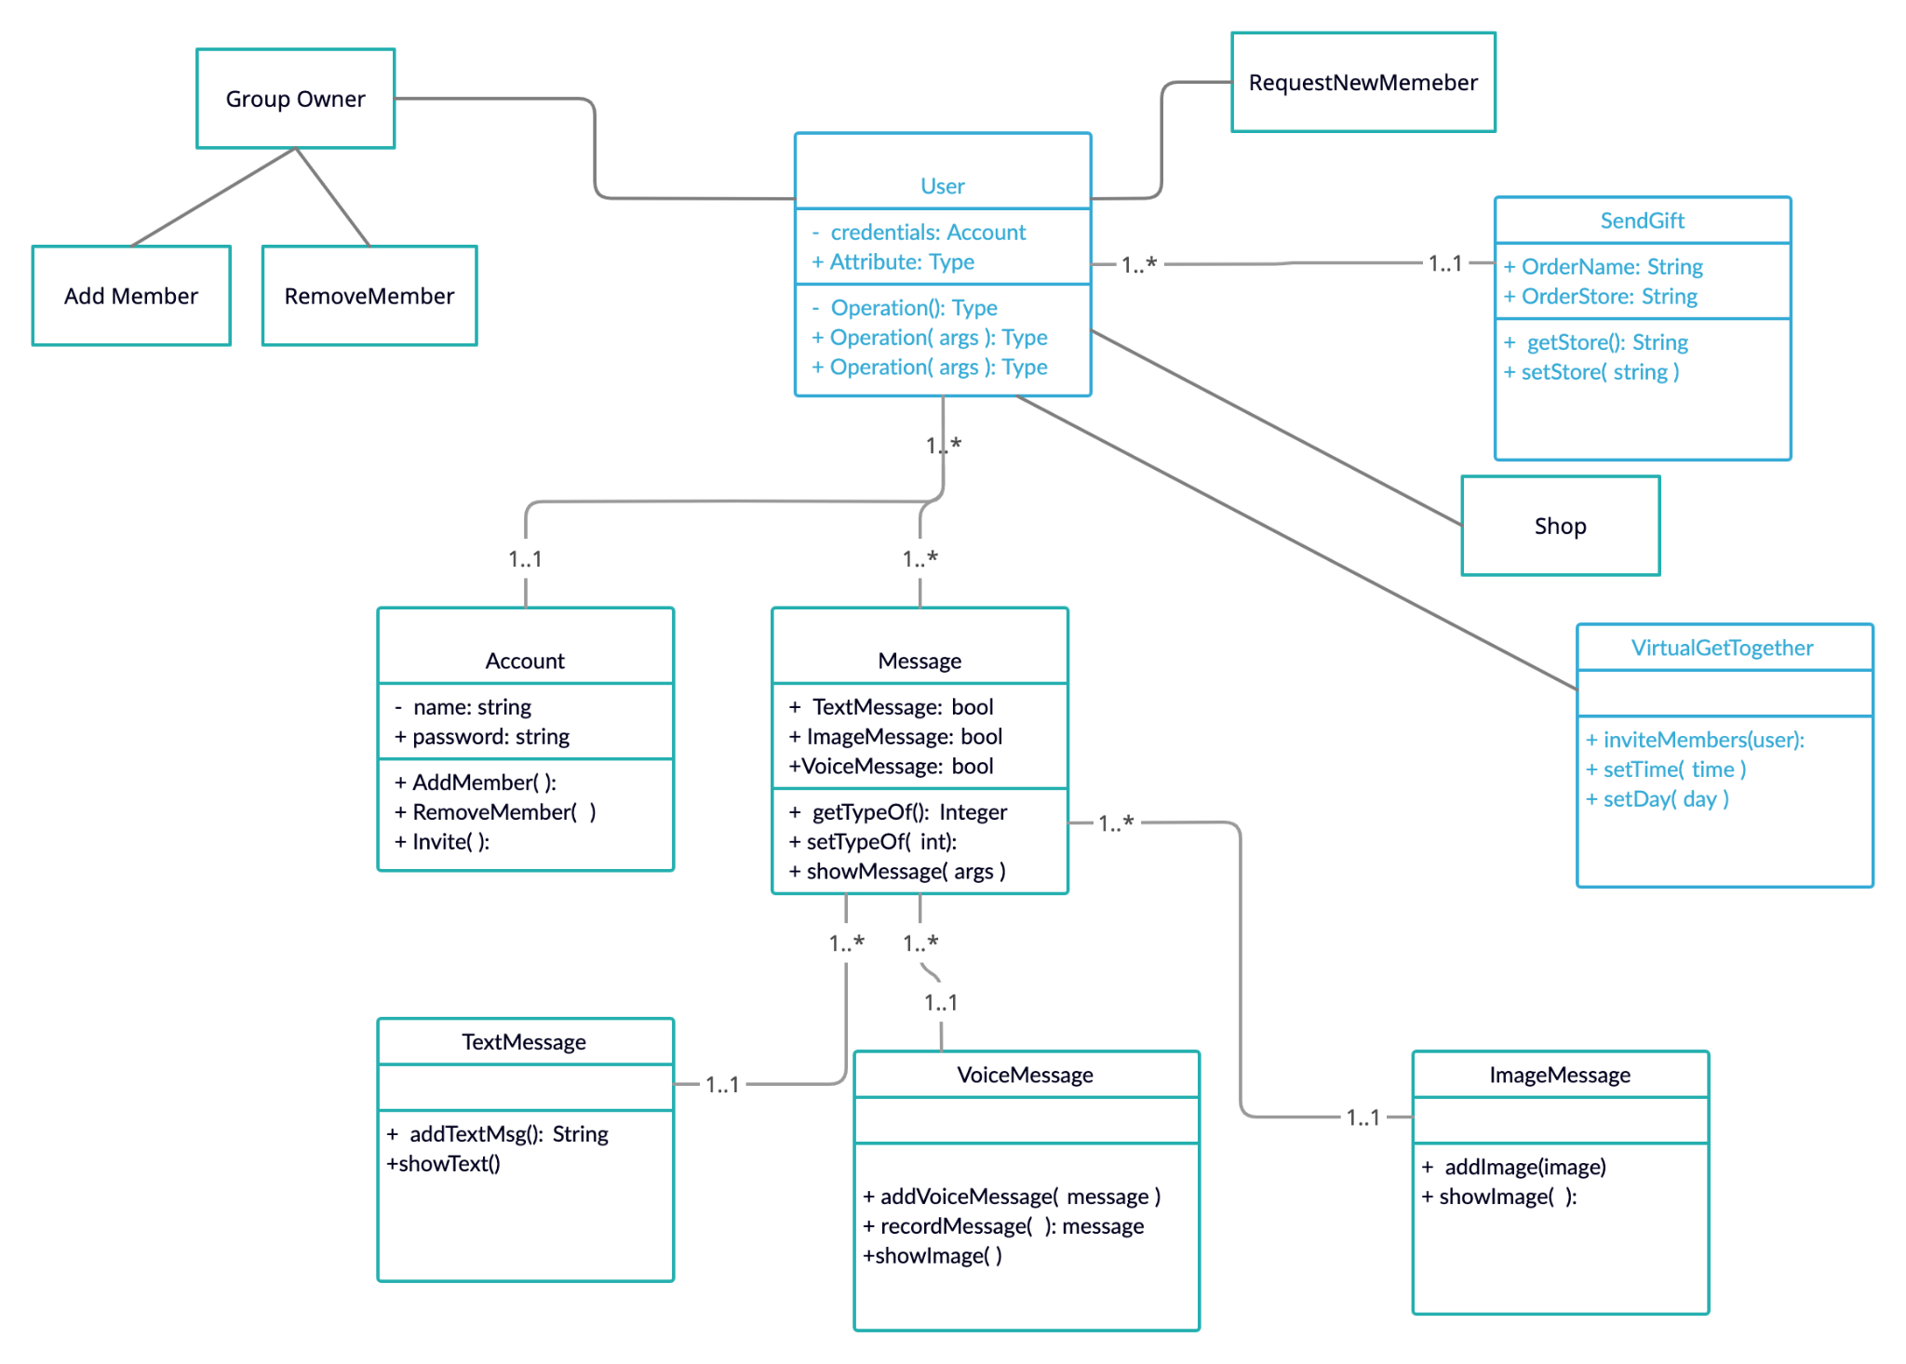
Class Design

Slide 6
Test plans
Account Creation - User’s account is created if email is valid, username is available and password meets criteria.
Product Tutorial - User is guided via a video/text on how the product works and how each feature enhances their experience.
Group Creation - User is walked through a series of options to create a project by customizing the group settings.
Reminders - The product sends a notification to the user’s device reminding them of any upcoming events.
E-commerce Integration - Users will have access to popular e-commerce platforms such as Amazon, Ubereats, DoorDash, etc., which will allow them access to their daily needs while intensifying user experience.
Popup Quizzes - Users will have access to sharing their shopping choices with the other group members during important events such as birthdays and anniversaries.
Group Timeline - Users will be able to share their lifestyle in the form for small video clips with the other members of the group.
Group/Individual Chat - Users will be able to interact with separately or via group chat.

Slide 7
Competition with other products
Competition | What they provide that we too…? | What we provide that they don’t…!
WhatsApp (smartphone) | Group chat and video, live location sharing, media sharing. | Integrated game leaderboards, remote sending gifts and packages with exclusive offers, complete multi platform support, tons of customization and personalization.
Microsoft Teams/Zoom (PC) | Full desktop support, office related work support. | All the smartphone features are available on computer as well. No compromise.

Slide 8
Ideas and future additions
Independent delivery system and direct association with shops and restaurants for faster, more accurate, and cost effective delivery.
Auto generated quizzes for the group members to play on birthdays having questions about lifestyle of the birthday person, and small in app games for fun.
Google calendar integration for household tasks, office routines, daily routines of group members, birthdays, important events, etc.
Office version of the application that can support variety of workflows according to the need of the user.

